Slide 1
Foundations Seminar: Data 8
Week 3

Slide 2
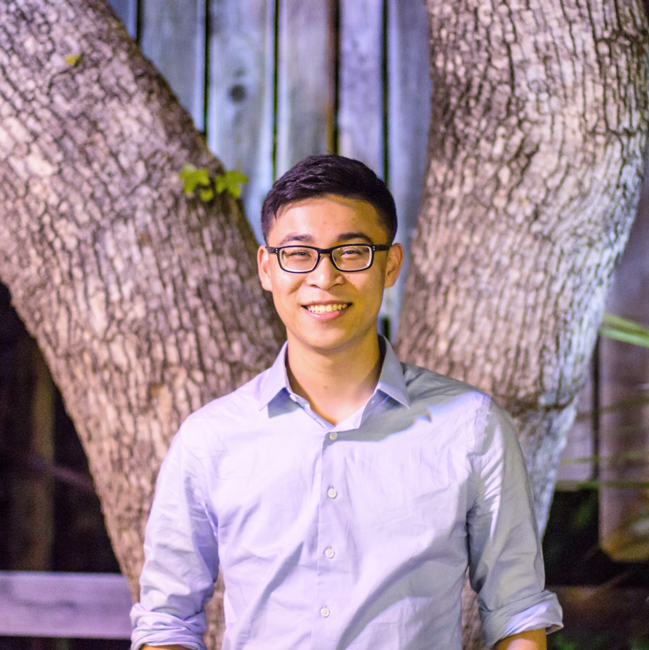
About me
3rd Year, Data Science Major, IEOR minor
From Palo Alto, CA
3rd Semester as a Data 8 Tutor
Took Data 8 Spring 2017
First time teaching this course!
Fun Facts:
I add 2 spaces after every period I type
I put in milk before cereal
You can occasionally catch me trying out bus routes

Slide 3
Contact Info
Email: oscar.syu@berkeley.edu
Office Hours: 10 - 11am Tuesdays 254, Sutardja Dai Hall
Additional (SUSA) Office Hours: TBD (likely Saturday 1-3 PM First Floor Moffitt)

Slide 4
Course Policy
Purpose of the class:
Allow you to succeed in Data 8, better understand what data science is, and how it can relate to your future
1 unit P/NP course
Entails 3 hours of work a week
1 hour → participating in tutoring sections
1 hour → coming to this seminar
1 hour (on average) → doing extra worksheets, assignments, perhaps a project at the end
Attendance Policy
NP after 3 excused absences OR 2 unexcused absences
Talk to me in advance about absences if possible
In-class check-in with me

Slide 5
Expectations
Come prepared with questions
Be ready to engage with your peers
This class is meant for you to have a community, don’t just work on your homework: actively engage in teaching and learning from each other
Do the assigned work: I’ll check at the beginning of class
Stay focused in class!
Have fun, make friends!

Slide 6
Typical Class Structure
Depends on what is going on in Data 8
Most weeks:
15-20 minutes class discussion of topics
Rest of time: ask questions, collaborate, do worksheets
Project weeks: reduced conceptual focus, more time to work on projects, get help
Functions more as an office hour time
Exam weeks: Data 8 Bootcamp - Do practice problems, tackle tricky problems
After exams or “off weeks”
Guest speakers, may be entire class, or just portion of it
Material outside of Data 8 - industry standards, careers in data science, data ethics, etc.

Slide 7
Class Material
Fill out the survey: https://tinyurl.com/d8scholars
I’m going to try to gear this class to your needs
Possible outside topics + supplementary activities
Pandas, Visualizing data
Data storytelling
Q&A with professors/Division of Data Science staff
Data Ethics
Applying data science to other fields

Slide 8
General Tips to do well in Data 8
The Standard:
Textbook - almost all your answers are there!
Use Piazza - browse for tips, private messages for specific help
Go to OHs
Don’t underestimate the concepts - make sure you fully understand them
Practice is the best way to ace this course
The Hidden:
Be nice and polite on your regrade requests
Data 8 problems almost always are never ambiguous. Yes or no answers. Try to explain answers in a concise and clear way.
The course is a culmination of many topics - one exam, or one topic will not define how you do in this class. However, everything is interconnected and builds off each other.
Don’t forget how to code when the course shifts to statistics

Slide 9
Questions on the material so far?

Slide 10
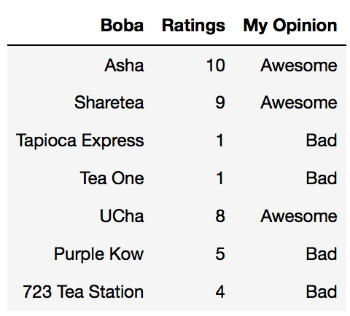
Example

Slide 11
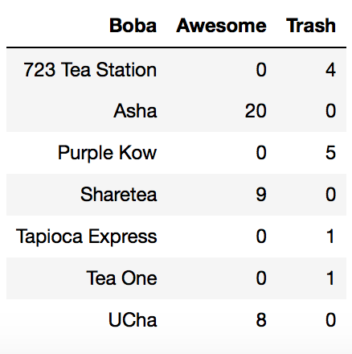
Problems
What’s my least favorite boba shop? What’s my favorite?
Select only the good boba shops. How many are there?
Give me a table of the first 2 columns
Find my average rating for each of my “Awesome” and “Bad” opinions in a table
An array of the names of the best 2 boba places
Find the average rating of the bottom 3 boba places
Give me the following output:

